Slide 1
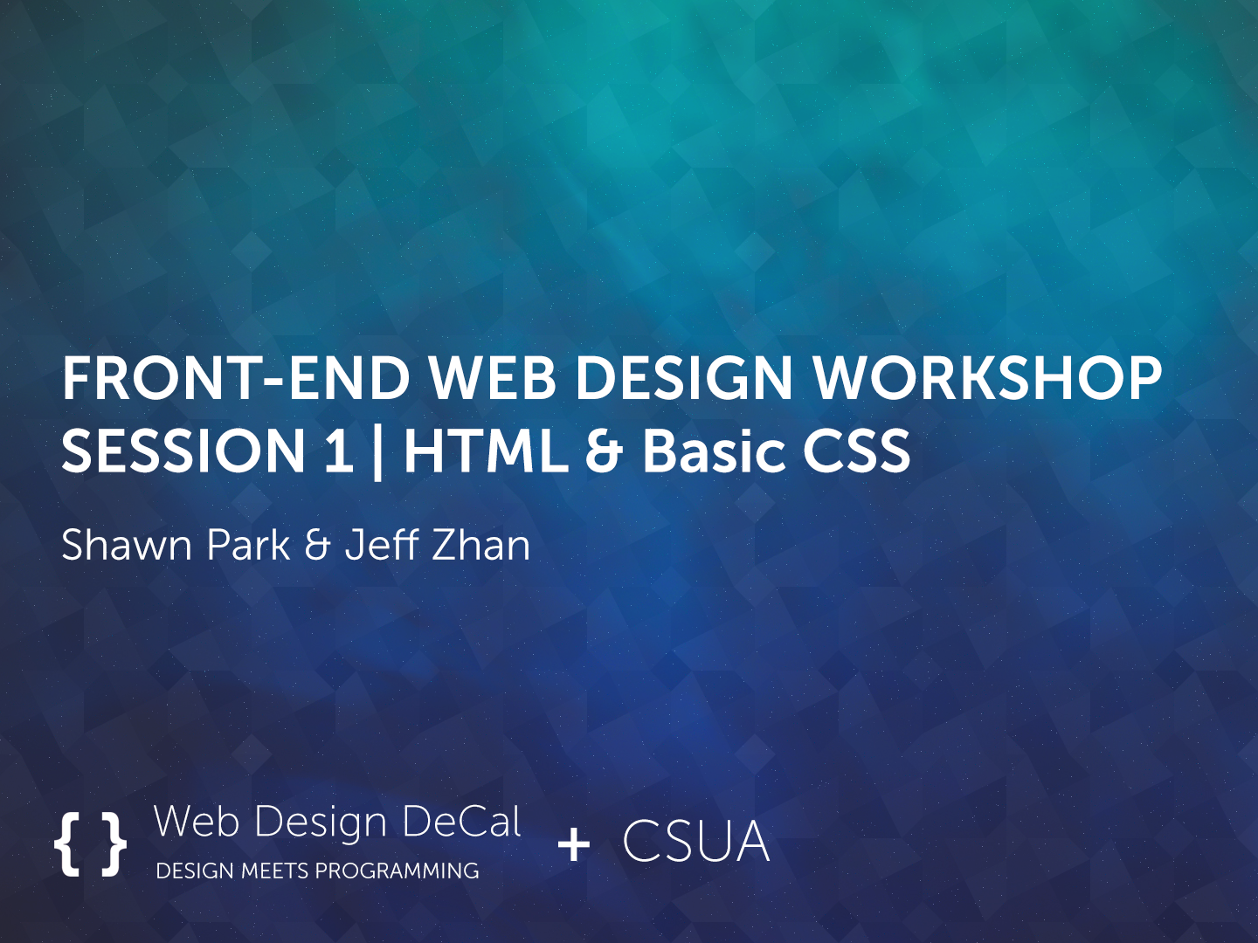

Slide 2


Instructors
Shawn Park
3rd Year Computer Science Major
From Ulsan, Korea
Interests: UI Design and Entrepreneurship
Hobbies: League of Legends & Kpop
Currently working on a startup Iris

Slide 3

UI Design Workflow
UC Berkeley CET

Slide 4

Iris: A community for your interests

Slide 5

Instructors
Jeff Zhan
Programming Section
4th Year EECS Major
From Columbus, OH
Interests: Graphic Design and Web Dev
Hobbies: Working out, Drawing, Traveling
Worked at CloverInk and TubeMogul

Slide 6
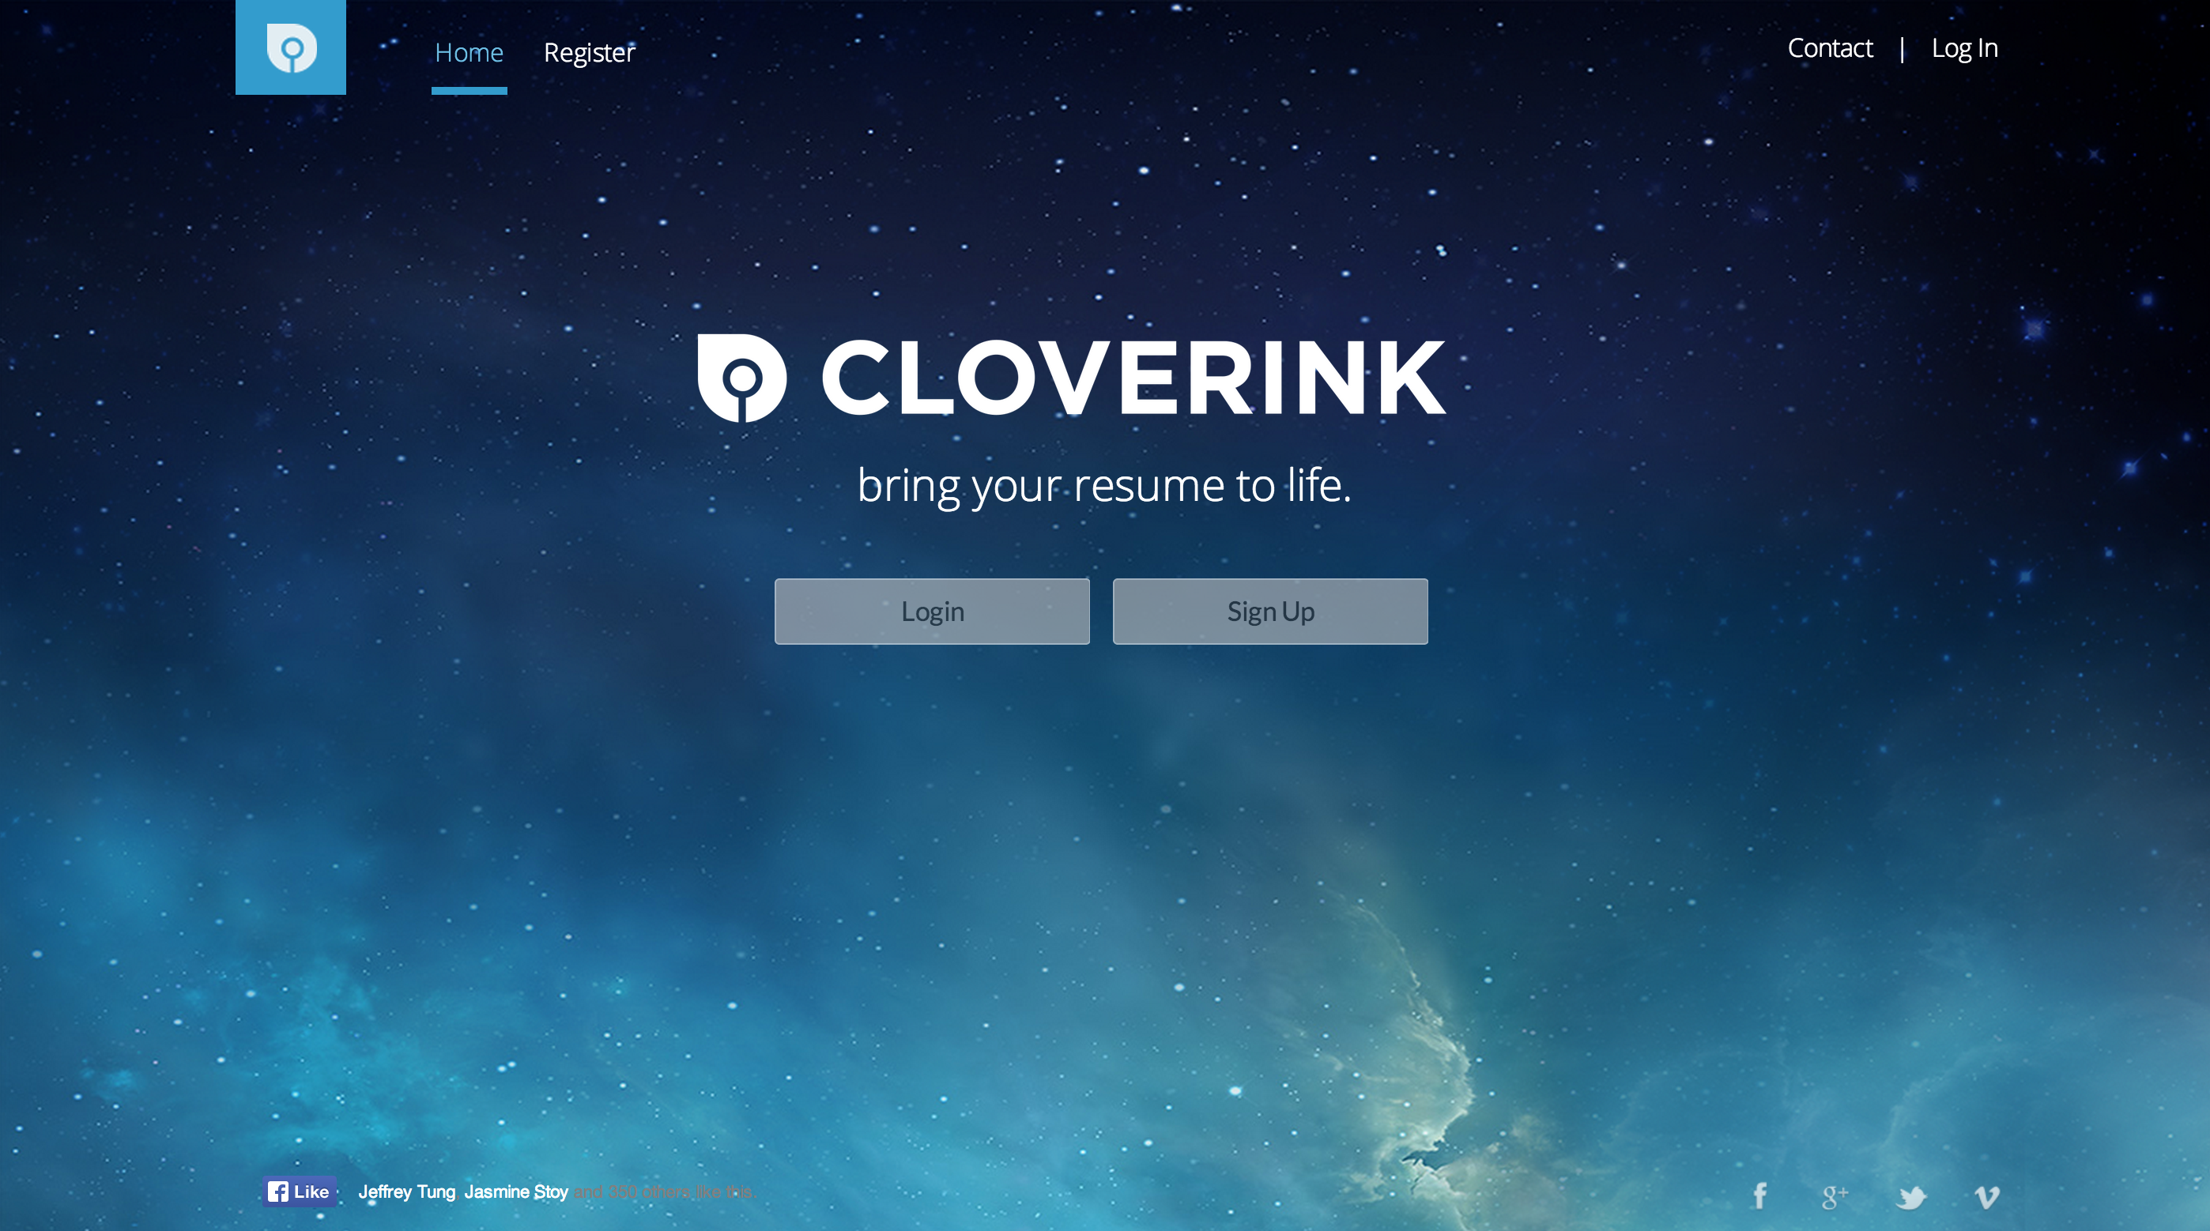
UI Design Workflow
Cloverink

Slide 7
Web Design DeCal
Held every semester (next semester too!)
2 Hours per week, 2 Units
Design section
Programming section
“Build your own website, a sexy one.”
Some exciting new additions to our DeCal next semester!
Industry mentors
Experts section

Slide 8
Today’s Agenda
Session 1 (6 – 7P): Introduction to HTML & CSS
Session 2 (7 – 8P): CSS Box Model & Specificity
Session 3 (8 – 9P): CSS Positioning
Session 4 (9 – 10P): Jquery & Javascript

Slide 9
Introduction to Web Design

Slide 10
Why learn Web Design?
So many use cases
Personal Portfolio
Web Application
Event Promotion
Essentially your online identity
Best place to start learning programming & design
Low barrier to entry compared to other programming languages
Quick to implement & iterate in terms of design
Design = First Impression

Slide 11
What Websites are made of
Front-end
What users can “see”
Back-end
What users can’t “see”
Ex. Buttons, Images, Text
Ex. Algorithms behind Logins, Search, etc.

Slide 12
What Websites are made of
HTML
Structure
= Skeleton
CSS
Design
= Clothes
Javascript
Function
= Muscle

Slide 13
HTML provides the structure of a page
A well-written HTML document should be “understandable” without a stylesheet.

Slide 14
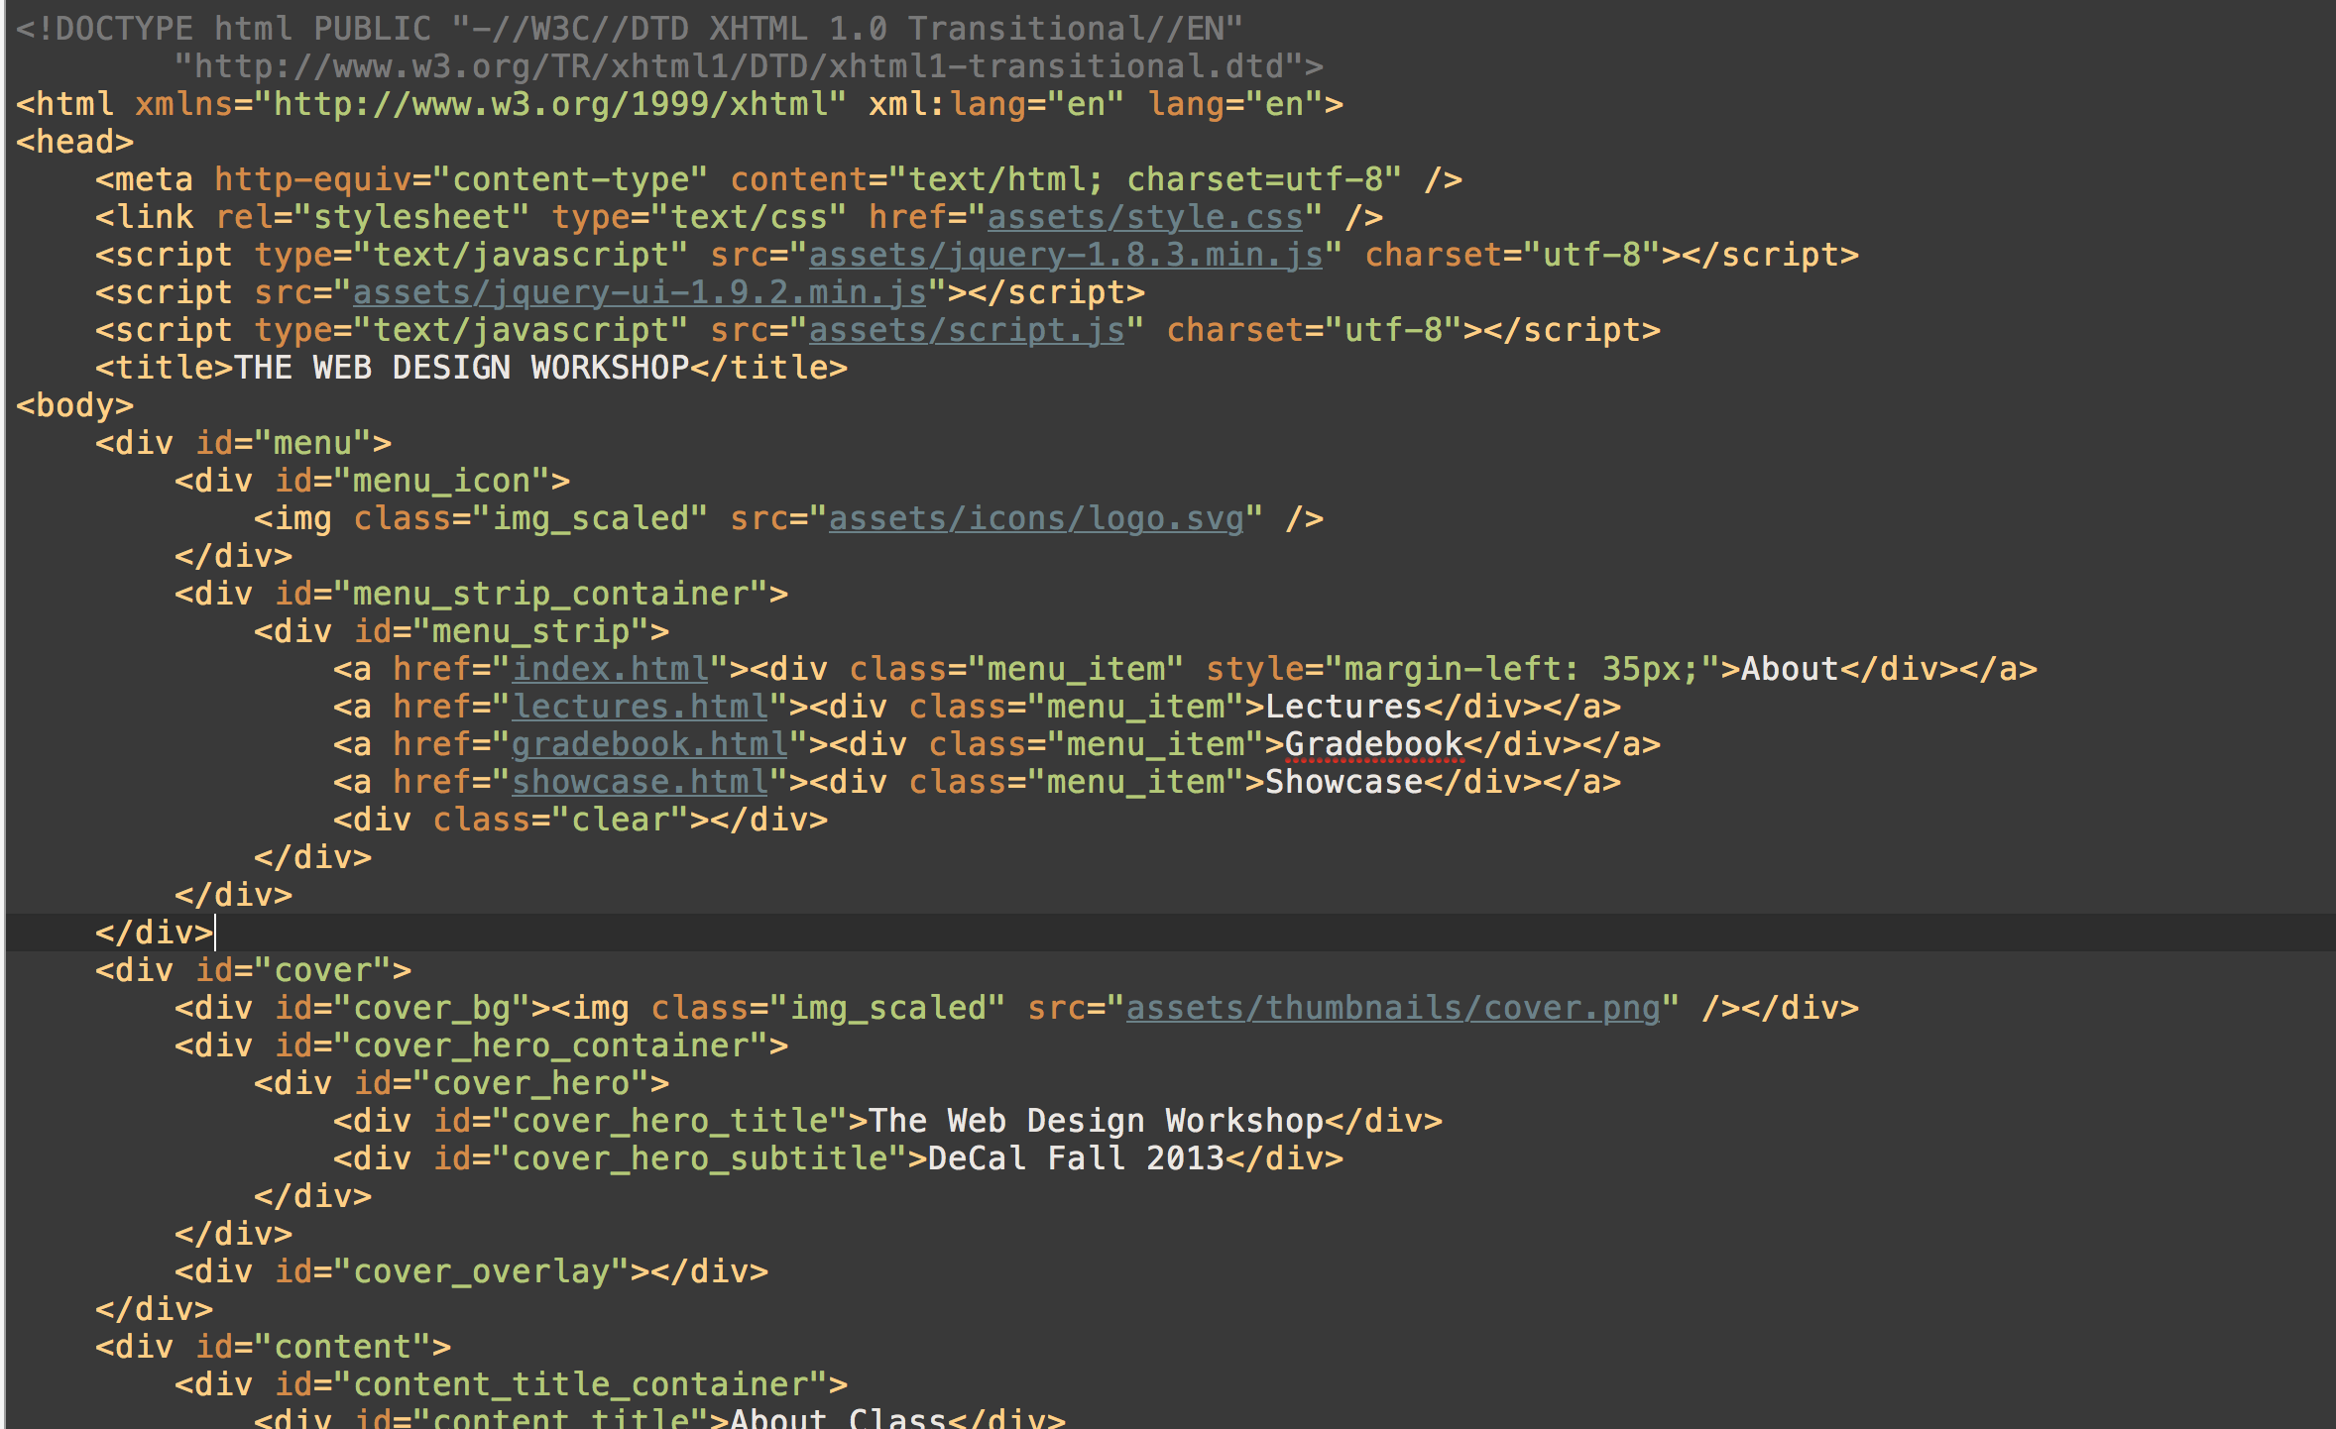

Slide 15
CSS provides the design of a page
Just several lines of “code” is enough to create “design” – shapes, color, buttons, you name it.

Slide 16
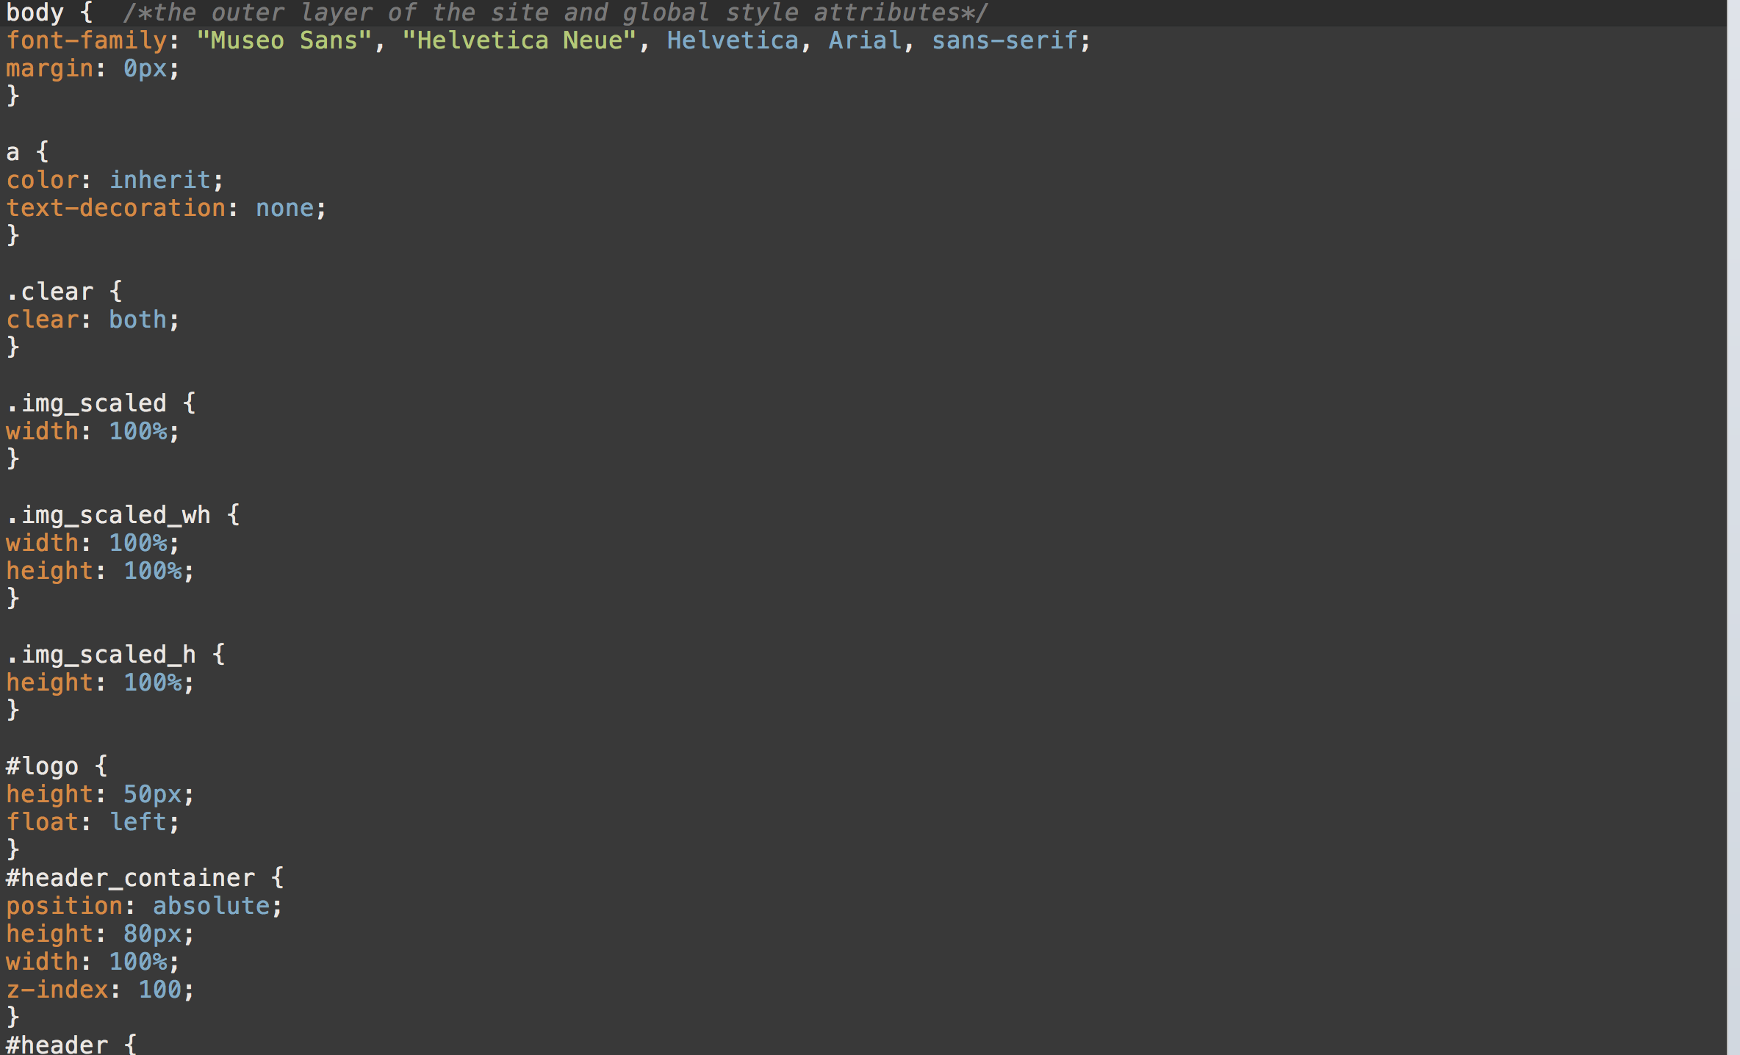

Slide 17
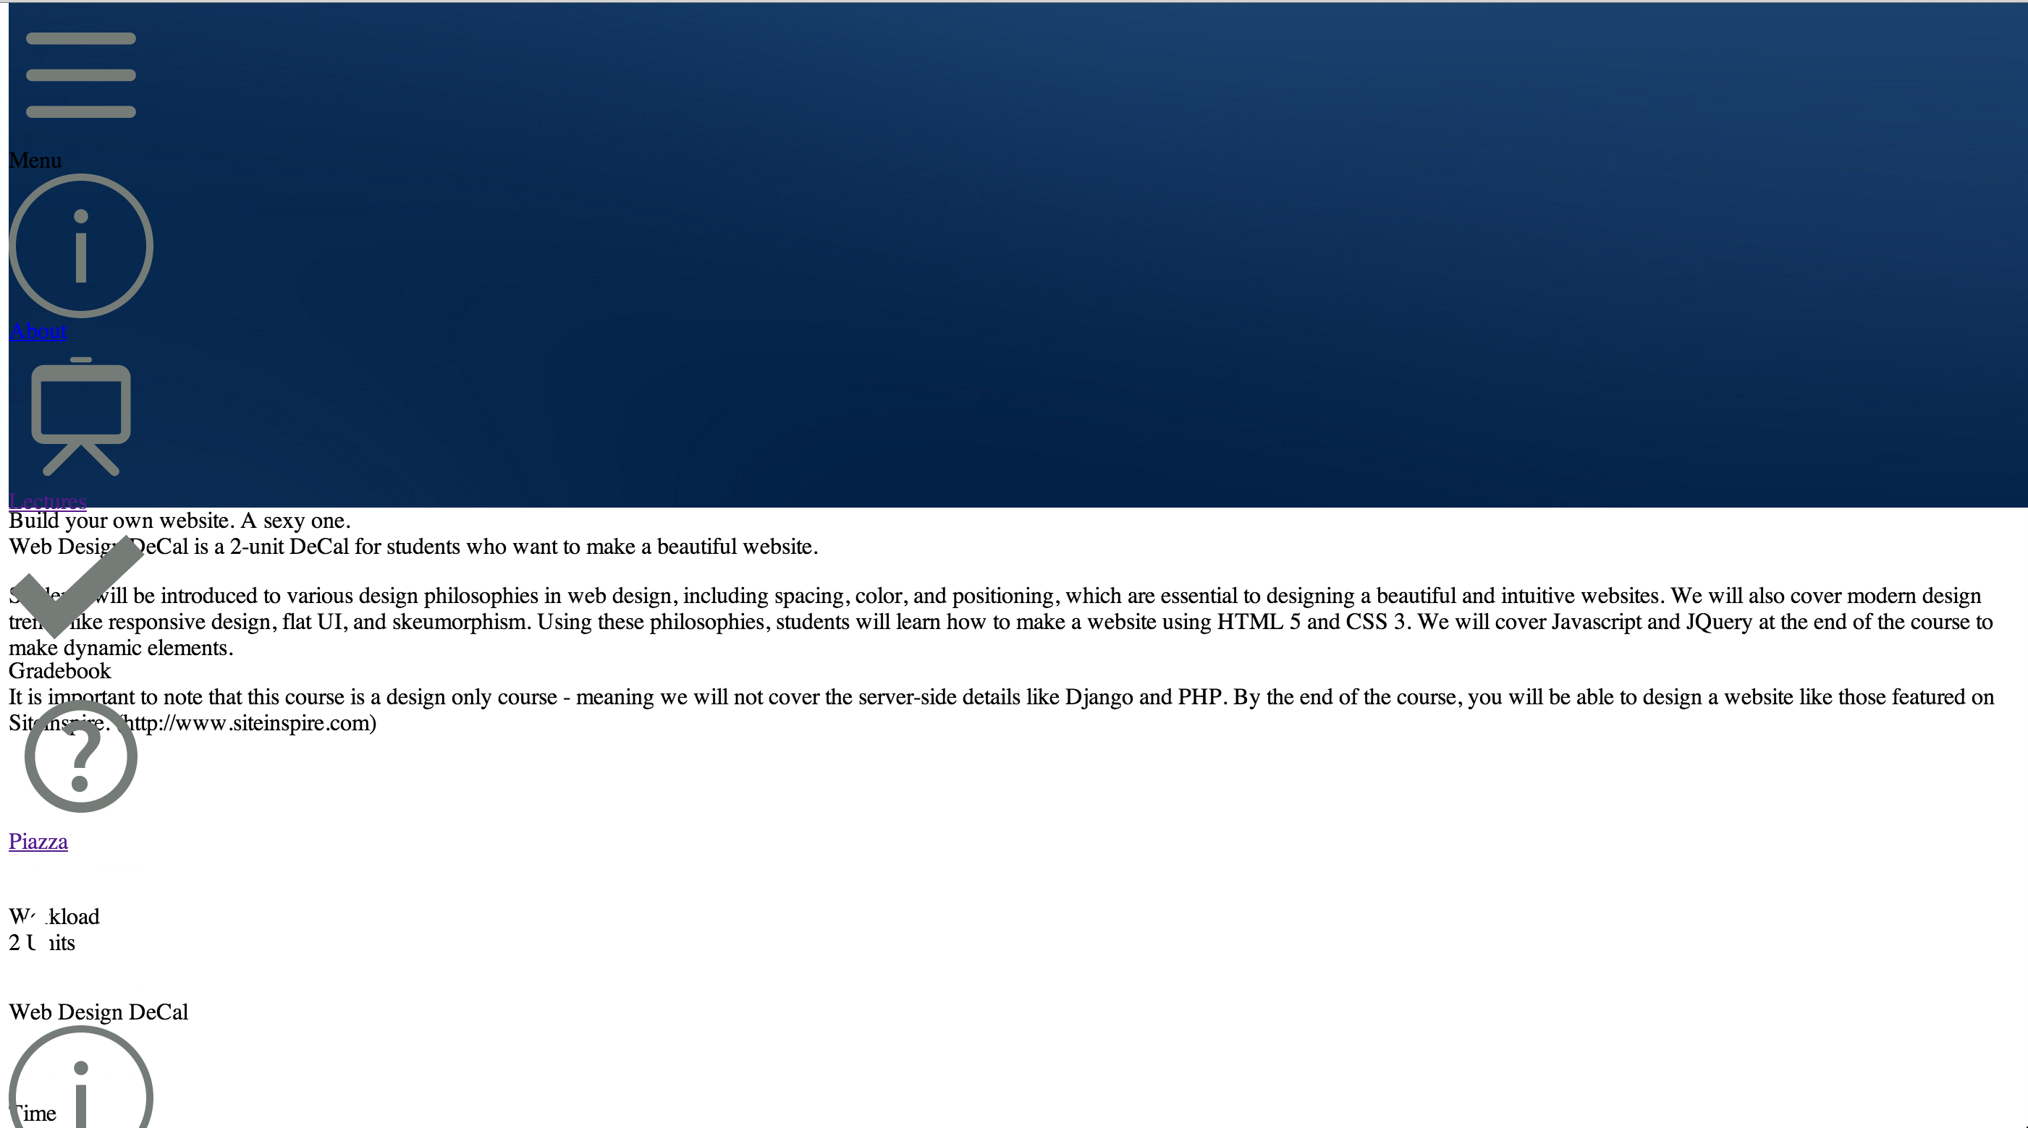

Slide 18


Slide 19
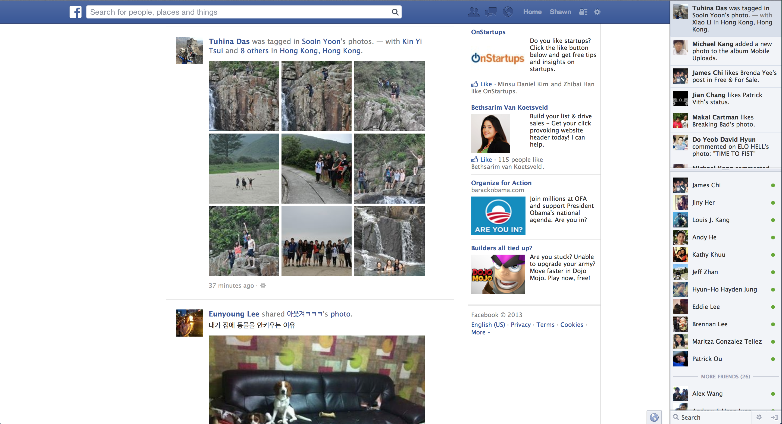

Slide 20
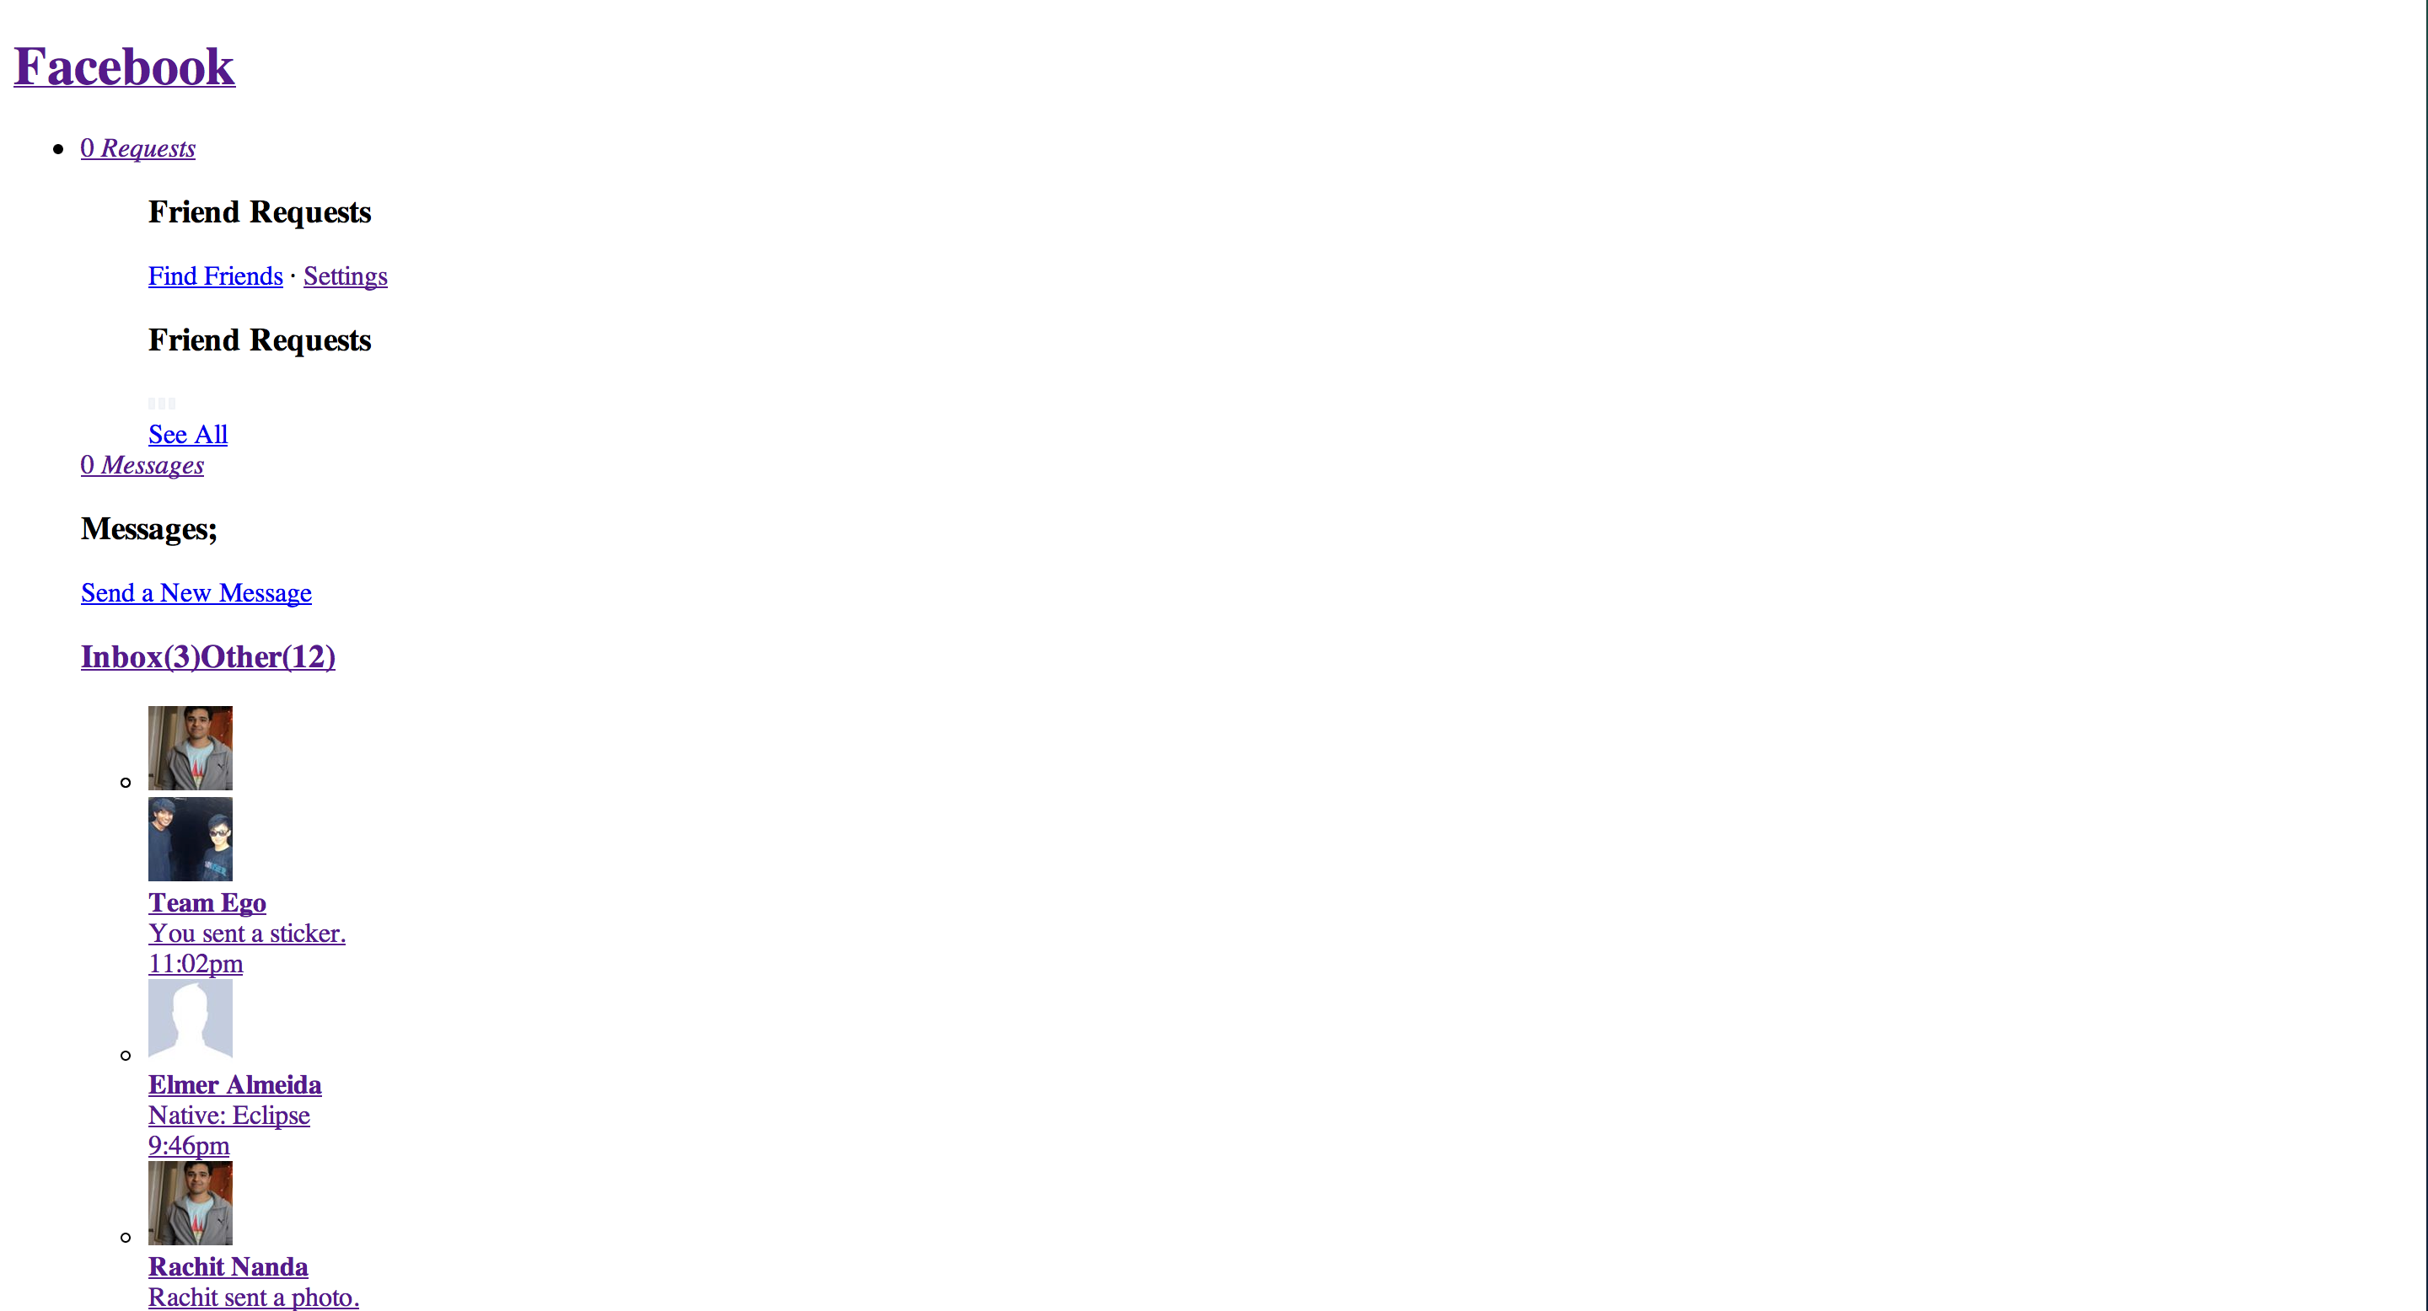

Slide 21
JS provides the function of a page
What will happen to the website with Javascript disabled?

Slide 22
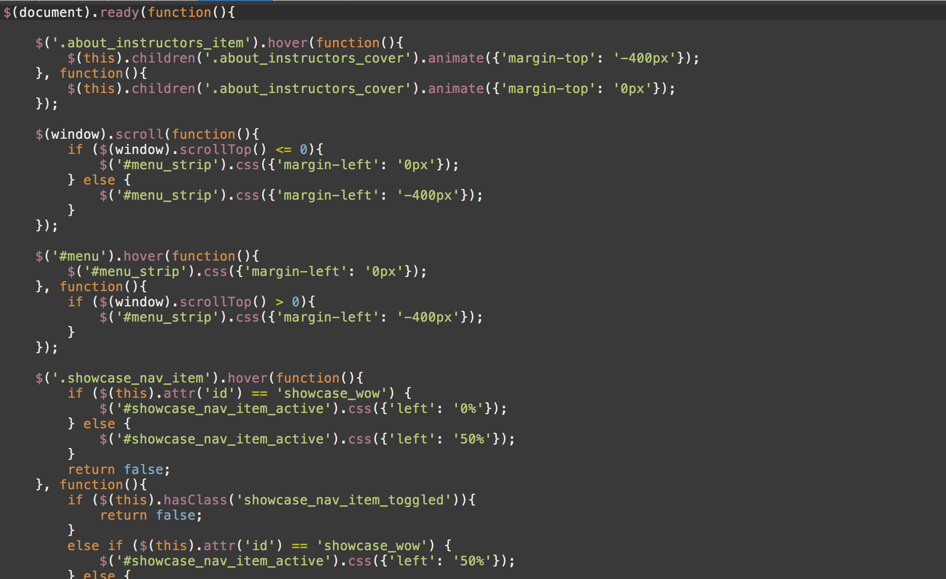

Slide 23
How do I make a Website?
Web Browser
Chrome
Firefox
Code Editor
Coda 2
Sublime Text
Image Editor (Optional)
Adobe Photoshop
Safari
Dreamweaver

Slide 24
UI Design Workflow
HTML
Code up the structure in a code editor
CSS
Stylize the website using the Web Inspector
JS
Add the missing functionality in the code editor

Slide 25
HTML Structure

Slide 26
Tags
Tags start with a left bracket < and end with a right bracket >
This is a paragraph tag: <p>
There are opening tags and closing tags. Closing tags start with </ instead
Example: </p>
Together, a set of tags is called an element
<p></p> is a paragraph element
You can add content between a opening and closing tag
Example: <p>Hello Class!</p>

Slide 27
Tags
Opening tags must have a closing tag
Not acceptable: <p>Hello!
Close it: <p>Hello!</p>
There are exceptions for special tags
Example: <br>
This is a line break tag
Also: <link type=“text/css” rel=“stylesheet” href=“style.css”>
This is a link tag to your css file (we will go over this later)

Slide 28
Basic HTML Structure
All webpages have 3 core elements to them:
HTML tag
Head tag
Body tag
The head and body tags are within the HTML tags
HTML
Head
Body

Slide 29
Basic HTML Structure
All HTML pages must start with the <html></html> tags
This tells the browser to render meaningful HTML code
Inside the HTML tags, put <head></head> tags
<html>
<head>
</head>
</html>
Notice we indented the <head></head> tags. This is for readability purposes (you could put everything in one line too, but we indent to make it easier for us to read)

Slide 30
Basic HTML Structure - Header
What goes in <head></head> ?
Title of page, links to css & javascript files, search engine keywords and description, website info, etc.
Everything not rendered on the page (the content)
Title
<title></title> tags
Defines the title displayed on browser windows/tabs

Slide 31
Basic HTML Structure - Header
<html>
<head>
<title>First Webpage</title>
</head>
</html>

Slide 32
Basic HTML Structure - Body
What goes in <body></body> ?
Content for your page
This is what the viewer sees
Heading Tags
<h1></h1>, <h2></h2>, …, <h6></h6>
6 default heading sizes. 1 is the largest, 6 is the smallest
Paragraph Tags
<p></p>
Adds some space above and below your paragaph

Slide 33
Basic HTML Structure - Body
Other Useful Tags
<br> for a line break (jumps to next line for a text)
<strong>…</strong> for bold text
<em>…</em> for italicized text
<hr> for a single horizontal line

Slide 34
Images & Links

Slide 35
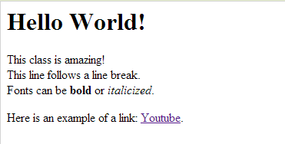
Images & Links
Links
<a>…</a> tags
Also called anchor tags
Example:
<a href=“http://www.youtube.com”>Youtube</a>
href is an example of an element attribute
Attributes are followed by = and “…”, with something in “…”
href needs a url inside the “…”. Can be relative or absolute
Between the <a>…</a> tags is the text displayed on the browser

Slide 36
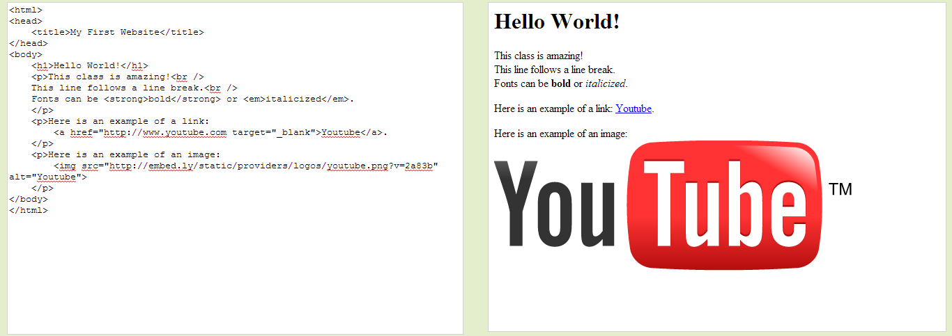
Images & Links
Images
<img> tag
Image tags rely a lot on HTML attributes (like href in anchor tags)
src attribute
Defines the image source (either relative or absolute path)
Example: <img src=“/path/to/filename.png”>
height & width attributes
<img src=“/path/to/filename.png” height=“100” width=“100”>
Note: Number is in # of pixels
alt attribute
Example: <img ... alt=“yo!”>
Displayed if image is unavailable, or is read if using screen reader

Slide 37
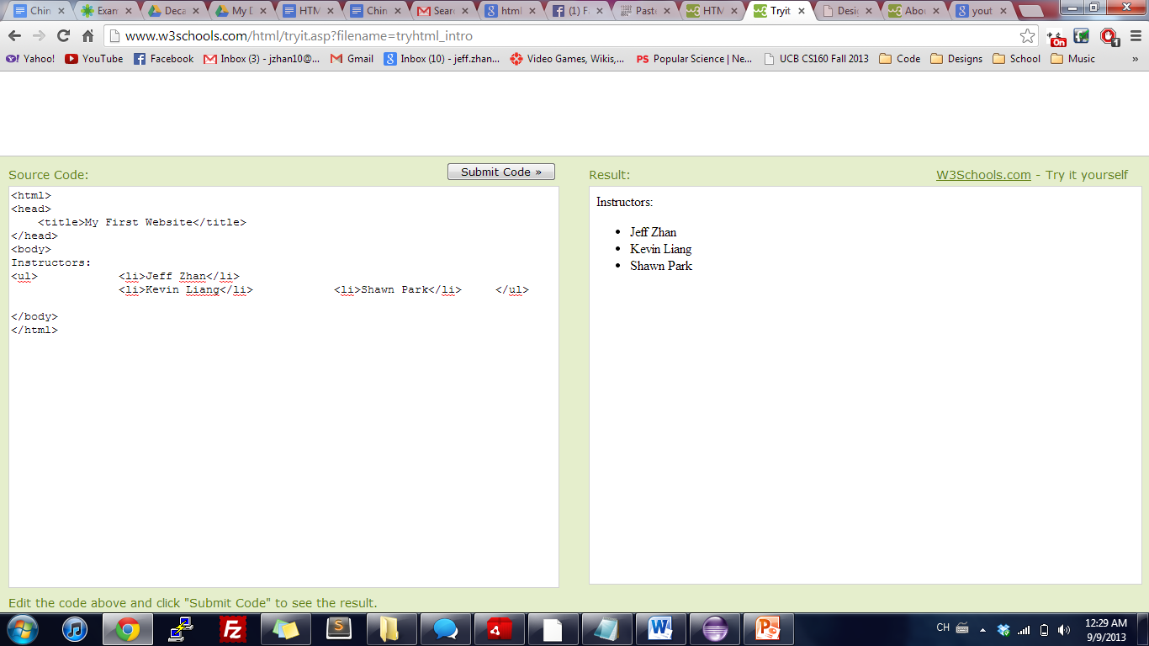

Lists
Unordered Lists (bullets)
<ul> <li>Jeff Zhan</li>
<li>Kevin Liang</li> <li>Shawn Park</li> </ul>
Ordered Lists (numbers)
<ol> <li>Jeff Zhan</li>
<li>Kevin Liang</li> <li>Shawn Park</li> </ol>

Slide 38
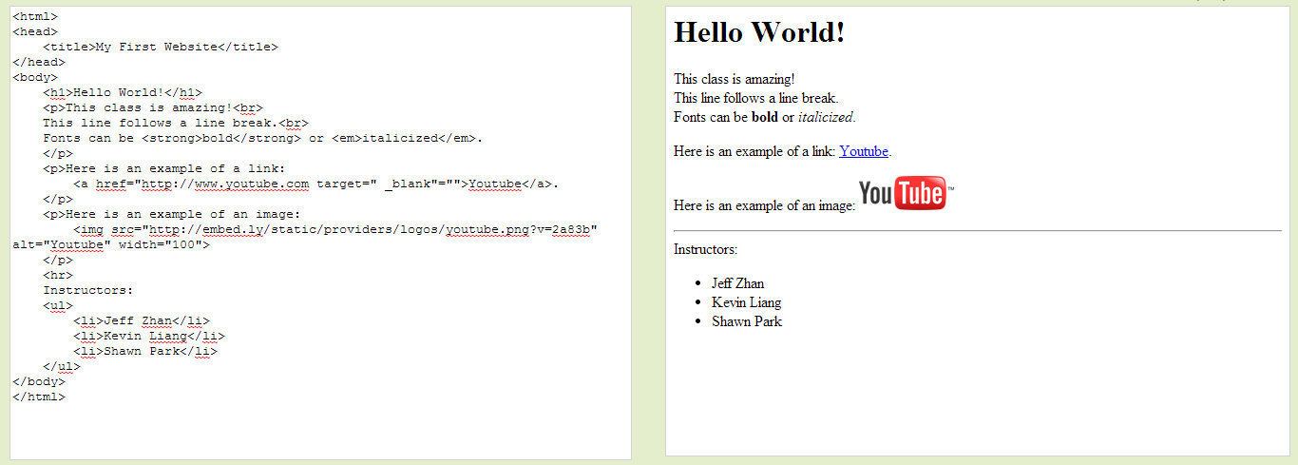
Lists

Slide 39
Hands-on Session 1 My first website

Slide 40
Divs & Spans

Slide 41
Divs and Spans
<div></div> tags are the primary tags we will use from now on
They are essentially tags with no special properties (like <strong> or <h1>)
You customize them with CSS
They are stacked vertically, meaning you cannot have two divs side by side unless you alter the CSS
<span></span> tags are used from time to time
Like a div tag, they have no special properties
You customize them with CSS
They are stacked horizontally, meaning you can have two spans side by side

Slide 42
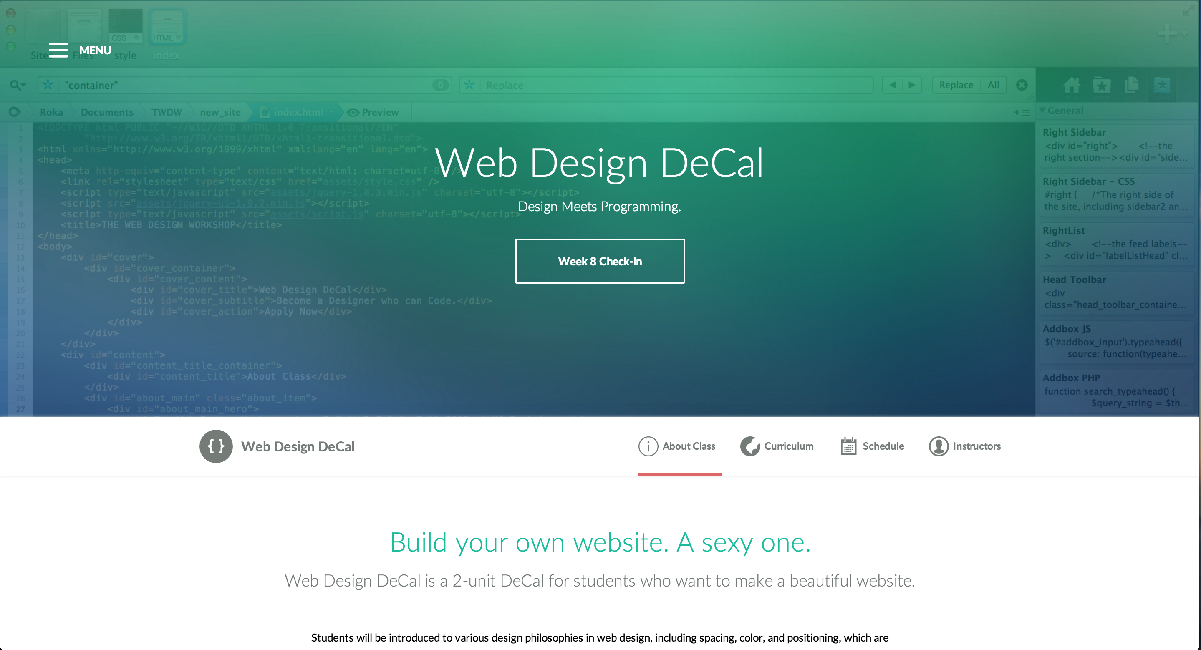
Web Inspector to the rescue!
Using divs to represent a website’s structure

Slide 43
IDs and Classes

Slide 44
IDs and Classes
IDs and Classes are both attributes to HTML elements
They look like this: <div id=“main-content”> or <p class=“intro”>
IDs
Unique to a single HTML file (no other IDs on page can have the same ID)
Classes
There can be one or more of the same class on a given page
IDs and Classes are important concepts for CSS. This is how CSS will select certain elements and style them

Slide 45
Intro to CSS

Slide 46
Intro to CSS
CSS stands for Cascading Style Sheets
They go in another file with an extension of .css
Link to the CSS file from your HTML file (in the <head></head> tags)
Basic Structure of CSS:
SELECTOR
p { color: red; font-size: 16px; }
PROPERTY
VALUE

Slide 47
Intro to CSS
SELECTOR
p { color: red; font-size: 16px; }
PROPERTY
VALUE
A “selector” can be the HTML element name, its ID name or Class name
It is followed by braces { }, with CSS property-value pairs in between
Properties define a CSS style
They are followed by a colon : and a value
Close property-value pairs with a semicolon ; (important!!)

Slide 48
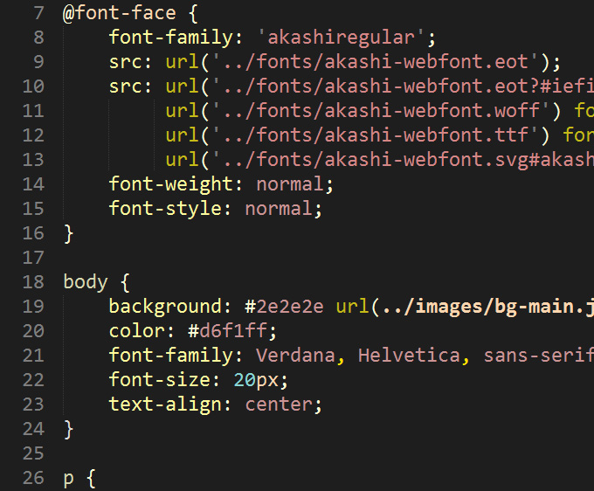
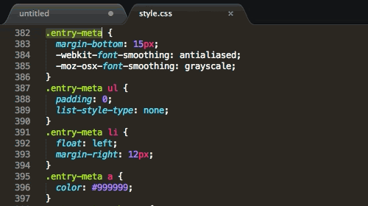
Intro to CSS
Sample CSS Documents

Slide 49
Intro to CSS
Selecting elements to style is simple
Use either the HTML element name, its class or its id
<p>Hello World!</p>
Select this element with p
Style p: p { color: red; }
What if you have multiple paragraphs, but want to style just the first one?
You can use IDs:
<p id=“intro”>Hello World!</p><p>My name is Bob.</p>
Select the ID intro:
#intro { color: red; }

Slide 50
Intro to CSS
Select elements by ID with a pound symbol #
Example: #intro { font-size: 16px; }
Select elements by Class with a dot symbol .
Example: .items { line-height: 26px; }
How would you select “Second Paragraph”? What about both divs?
<div id=“first” class=“paragraph”>
First Paragraph
</div>
<div id=“second” class=“paragraph”>
Second Paragraph
</div>
Answer 1: #second { … }
Answer 2: .paragraph { … }

Slide 51
Linking to CSS

Slide 52
Linking to CSS
3 ways to style CSS
Inline CSS
Internal Stylesheet
External Stylesheet
We will only cover the External Stylesheet, the most commonly used and best way to utilize CSS

Slide 53
Linking to CSS
In your HTML file’s <head></head> tags, include the following line
<link rel=“stylesheet” type=“text/css” href=“/path/to/style.css”>
It is a lot to take in! Thankfully, you can copy this line for all your HTML pages and just change the href attribute to any .css file
Just know this is a <link> tag, linking your HTML page to your CSS file

Slide 54
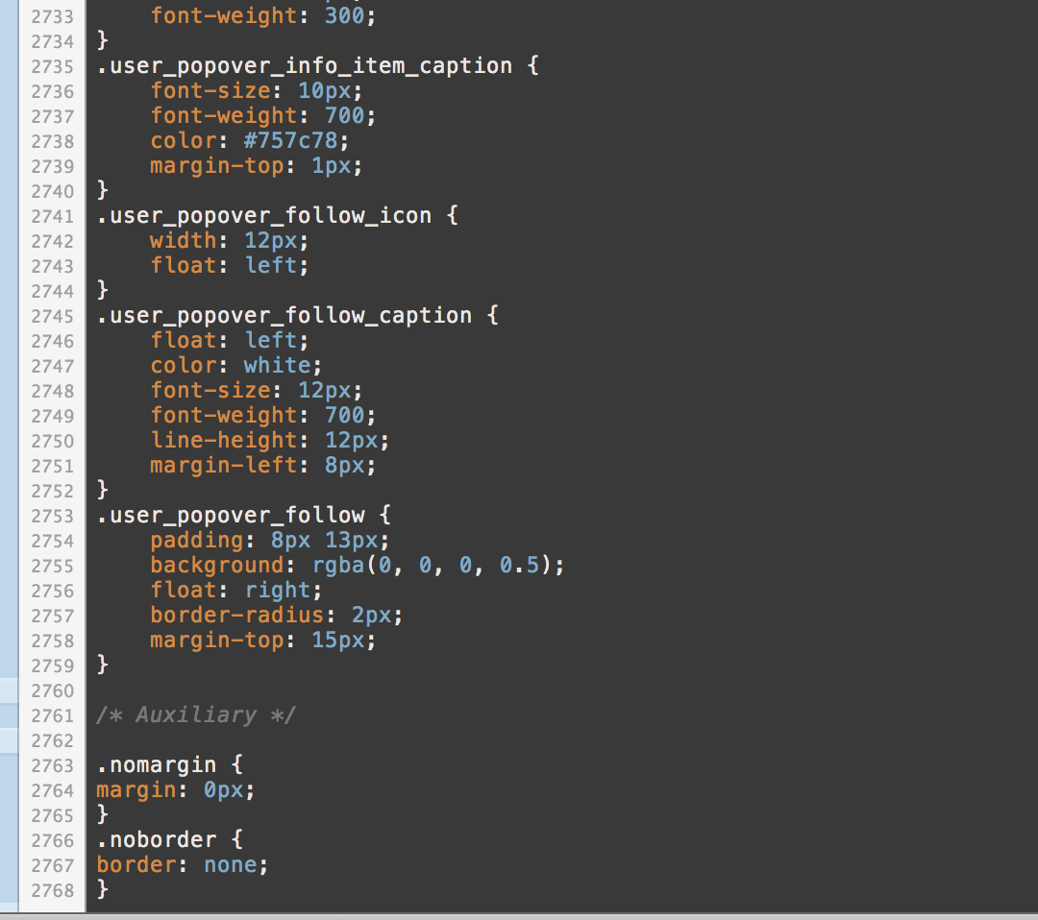
UI Design Workflow
Do I really have to manually type out 2000 lines of CSS?

Slide 55
Web Inspector to the rescue!
Allows you to test your designs in-browser
You can write out CSS rules and see how it looks live
No need to save a file, reload, etc.
Allows you to learn from other people’s work
Other functionalities (for front-end) include:
Autocomplete for CSS rules
Color Picker
Browser Compatibility Test
JS Debugger
3D View (Firefox)

Slide 56
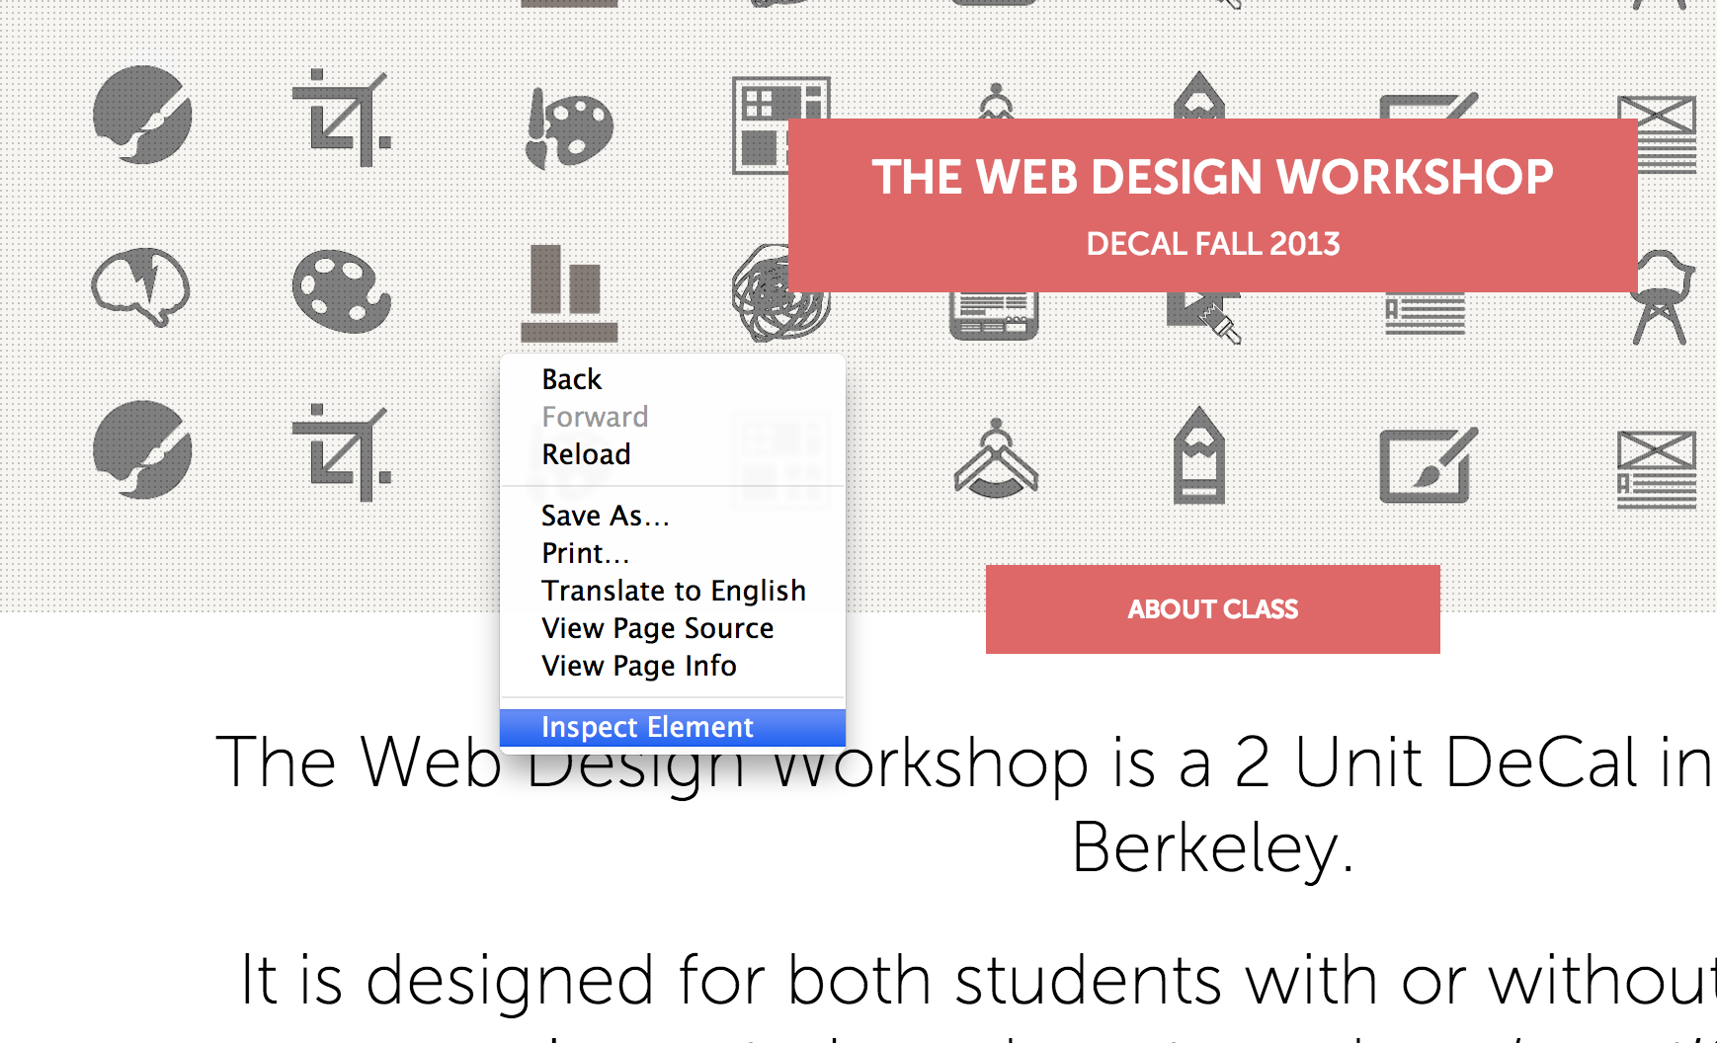
Web Inspector to the rescue!
How to open up Web Inspector

Slide 57
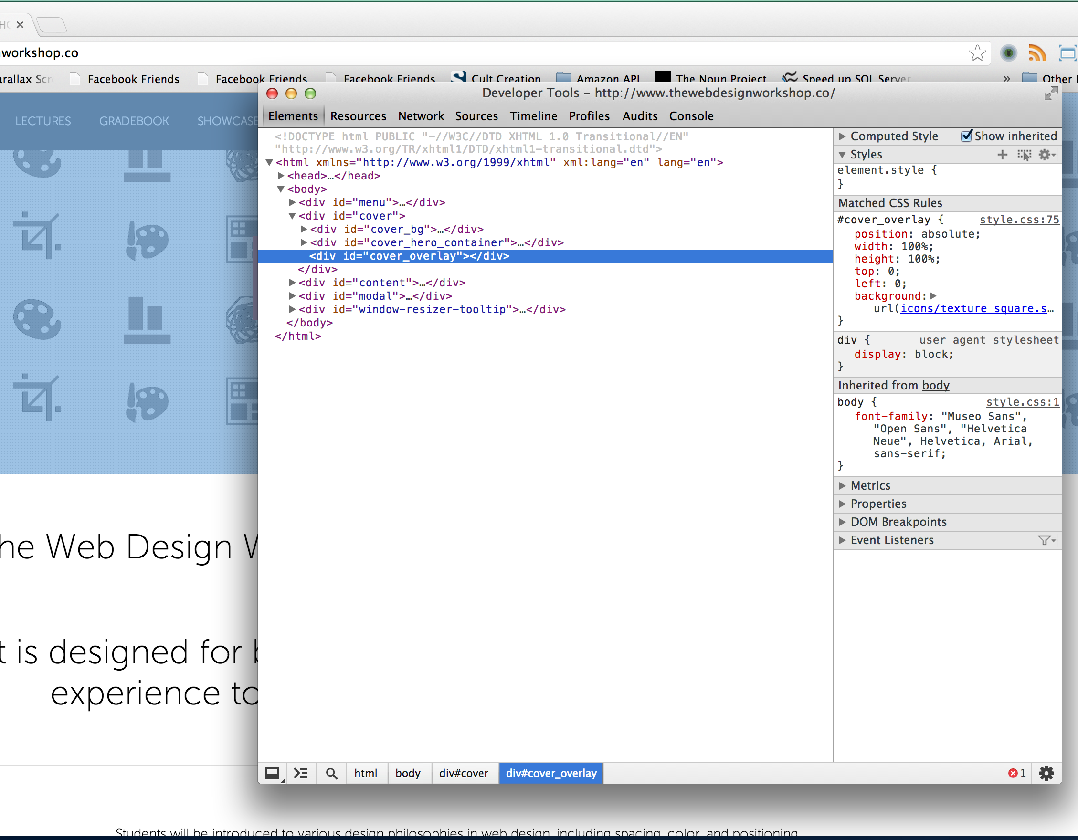
Web Inspector to the rescue!
The selected element is highlighted as Web Inspector opens

Slide 58
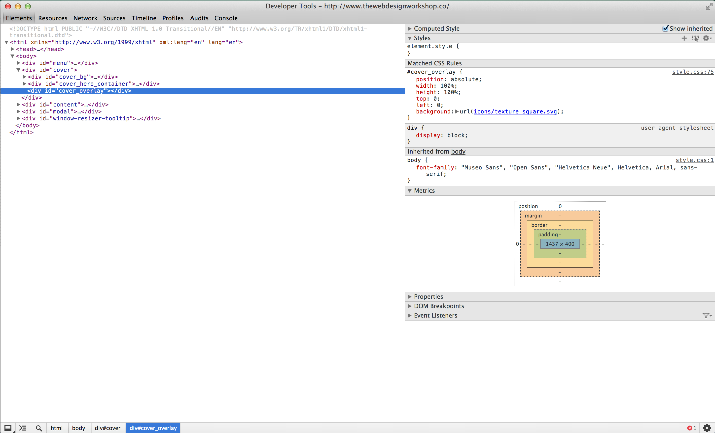
Web Inspector to the rescue!
CSS Editor
Selected Element
Metrics
Elements Tab of the Web Inspector A place for editing web site design on the fly
Notes:
Edit website designs
Peek at other people’s designs
Majority of time here

Slide 59
You will spend as much time on the Web Inspector as you will on the code editor
Try out the code on the Web Inspector before you write it on the Code Editor – It will save you tons of time

Slide 60
Web Inspector Workflow
Open up the Web inspector using “Inspect Element”
Find the element you want to edit, and enter new CSS rules
Fiddle around until it looks good
Take the final code to the Code Editor

Slide 61
A Few Caveats about Web Inspector
Changes you made in web inspector are NOT saved automatically
Must make sure changes are saved by:
Going to Resources Tab -> Find your CSS file and copy paste all the code to your CSS file (Modification)
Going to Resources Tab -> Find inspector-style.css and copy paste all the code to your CSS file (Addition)

Slide 62
Hands-on Session 2 Styling my first website

